Slide 1
Kit of Parts and Tools Rundown
Presented by Team 3350 (T-BOTS)

Slide 2
Students first
Students should lead their teams in the building, design, and all other aspects of the robot.
Knowledge of the Kit of Parts (KOP) and tools is the first step to a successful, student-led team.
Students must be put first for them to achieve their maximum potential, both in FRC and afterwards, as no one will do the work for them in college.

Slide 3
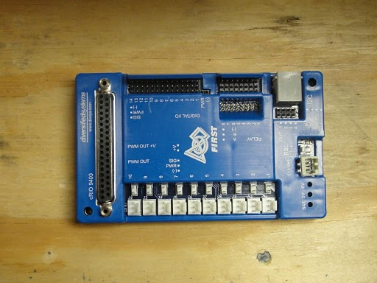
Digital Side Car
It connects the Crio to other devices such as motors and lights
It sends data information to control turning on/off to various motors and lights

Slide 4
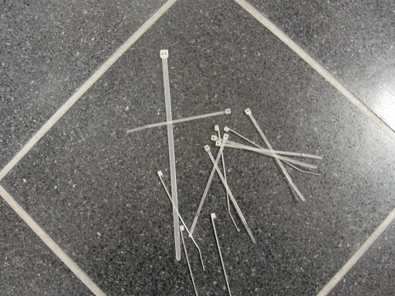
Zip-Ties
Zip-Ties might not seem like something that you would need to know much about but they do come in handy when you need to keep everything in place

Slide 5
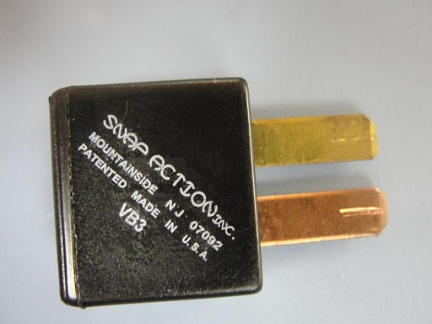
Circuit Breaker
You will need a circuit breaker for almost everything that requires electricity on your robot.
Are designed to fail if you go
Over a certain amount of
Electricity so that you do not burn out your robot

Slide 6
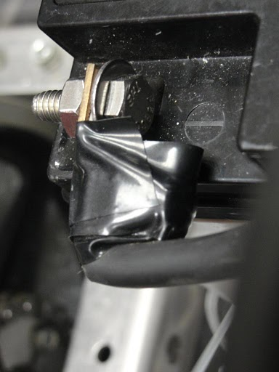
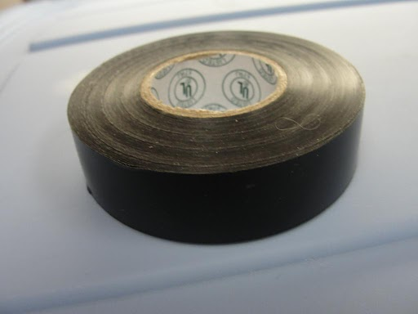
Electrical Tape
It stretches well and gives an effective and long lasting insulation. Although it is called electrical
tape, it does NOT conduct electricity.
It is used to protect both your robot and you from a harmful shock

Slide 7
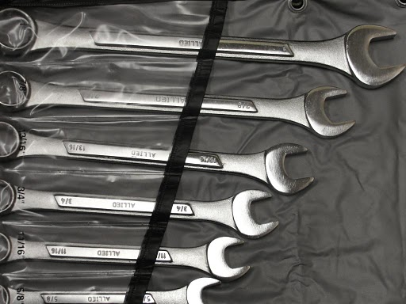
Wrench Set Universal tooth design grips six different types of nuts and bolts.

Slide 8
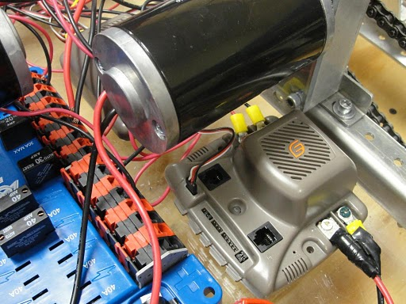
Speed Controllers (Jaguars)
The Jaguar module brings
new motor control technology
to the competition including
integrated limit switch inputs
that function in combination
with the brake/coast inputs.
In other words, it allows you to have a varying speed so that your robot is not just an on/off robot.

Slide 9
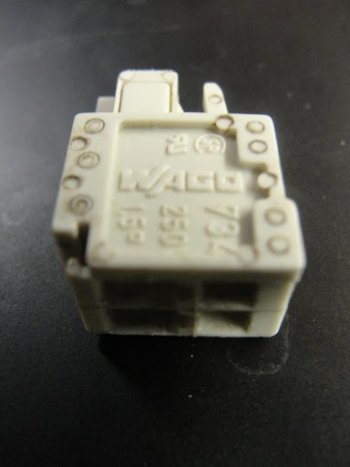
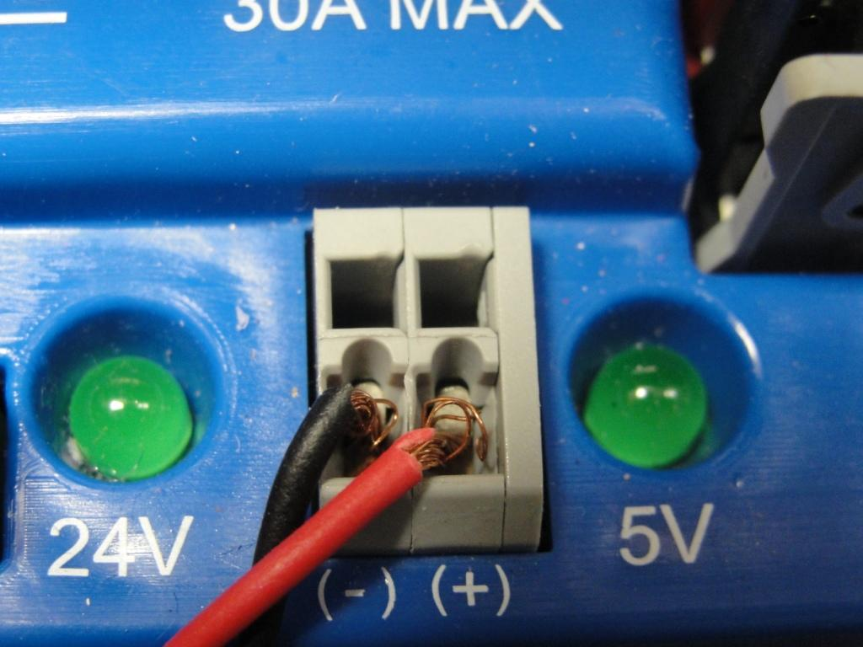
Wago Connectors
Used to connect your wires into the Digital Sidecar
Be sure not to lose them for they are easily lost and they are the only connectors that fit into the sidecar

Slide 10
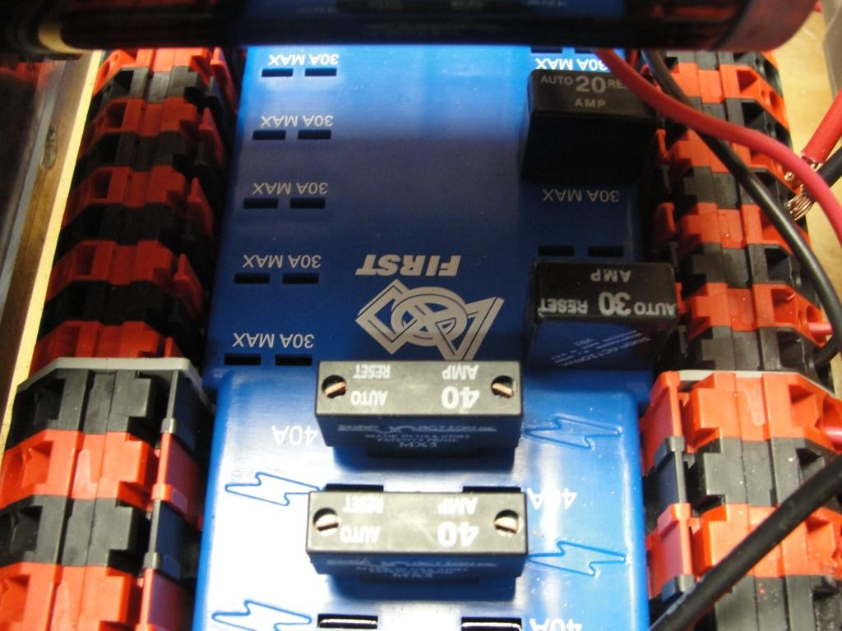
Power Distribution Board
Everything that runs on electricity must be connected to the Power Distribution Board
This is where you place your circuit breakers and connect your wires.
You must use the FIRST approved Circuit Breakers as we found out during the 2010 season.

Slide 11
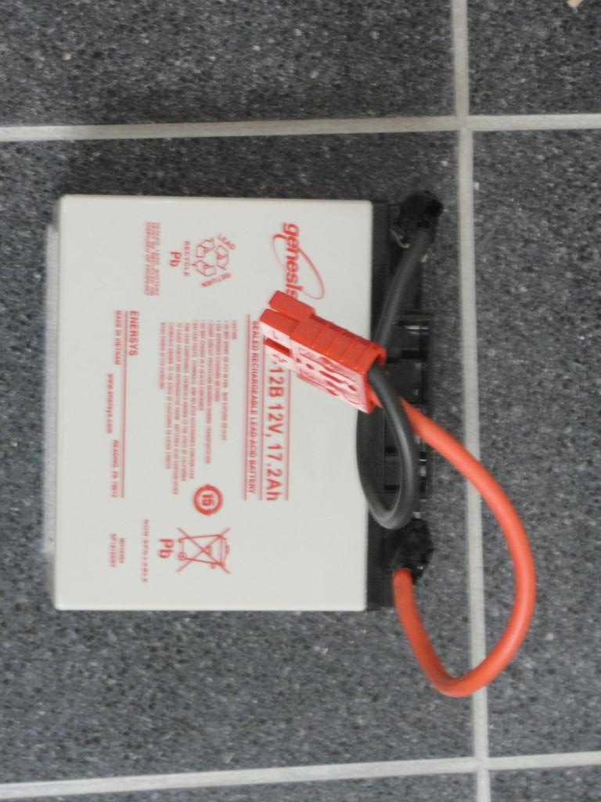
Battery
It connects to the Power Distribution Board
You want to make sure that you have your quick turn off switch/circuit breaker in plain view and easy access when attaching it to your robot.

Slide 12
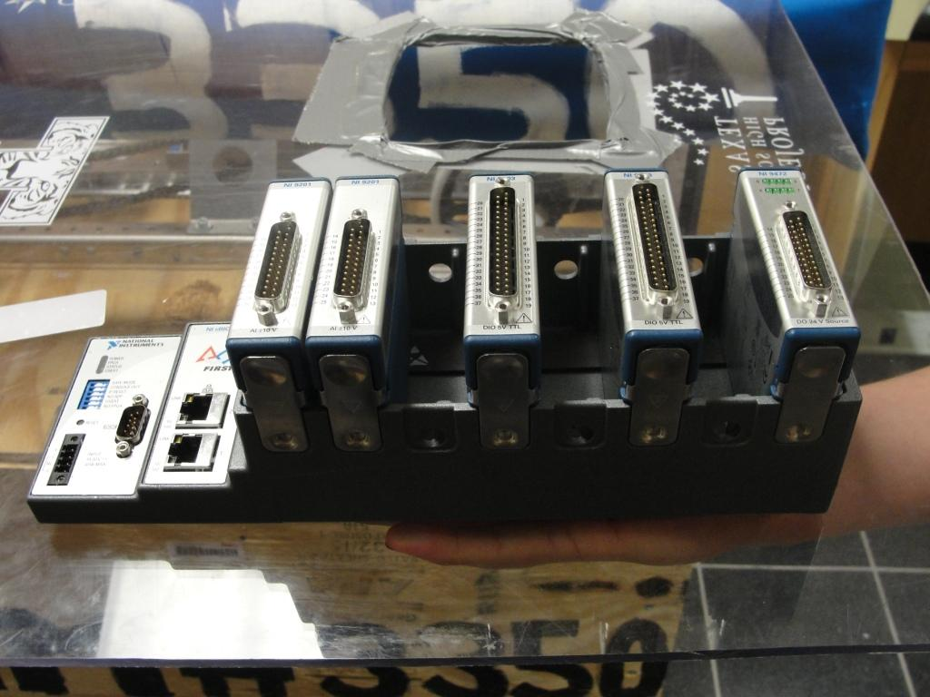
compactRio/cRio
It is the “brain” of your robot
It is the computer component of the robot that processes your input and output information and routes it to the correct location.

Slide 13
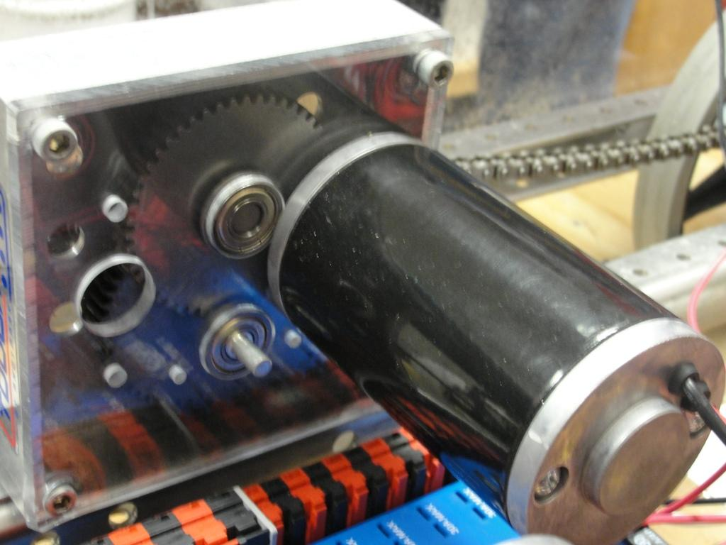
CIM Motors
There are many different types of motors in the KOP but these in particular are to be used for the wheels.

Slide 14
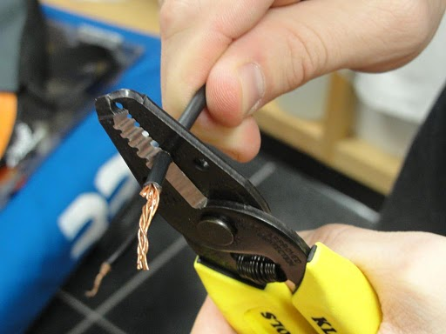
Wire strippers
Used to strip the protective covering used on wire to reveal the inner conductor.
Be extra careful because there is a small blade on almost all wire strippers and they should be handled carefully (it’s never fun to lose a finger)
Also, it is very easy to cut through wires as well.

Slide 15
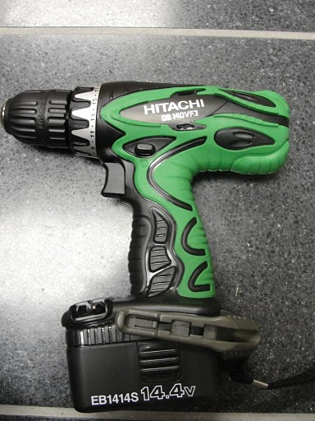
Power drill
Very self explanatory
You use the power drill to easily and quickly drill holes, screw in screws and to tighten nuts and bolts.
Most drills will come with an assortment of different bits that can be used for multiple projects

Slide 16
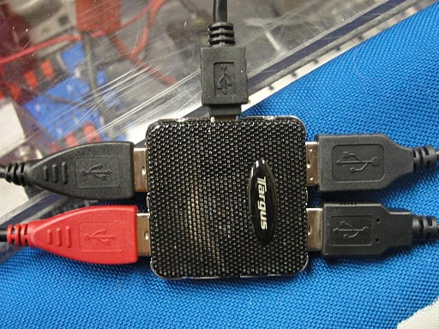
USB Hub
Because there are a limited amount of usb ports on the computer and almost everything you use such as: the joystick, stop button, etc. are attached to the computer via usb port, the Hub allows you to connect multiple usbs while only using one port on the computer.

Slide 17
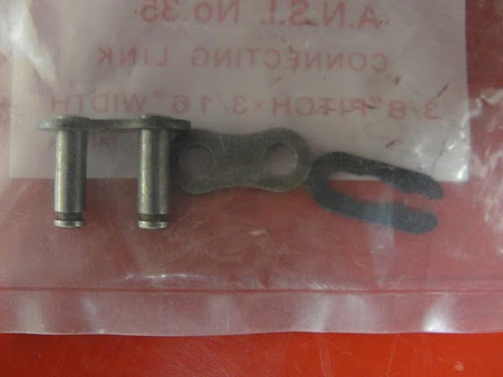
Master link
The link that you use to connect chain to chain.
Useful when you only have one chain that is not connected or when you have a long chain that you must cut.
Make sure that you have the right size though

Slide 18
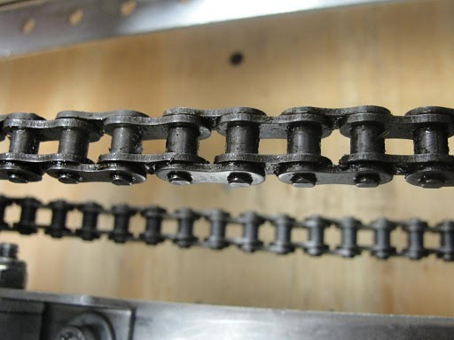
Chain #35
Transfers motion between two gears
Remember to keep the chain greased as it will cause problems later on if not
One side connects to the transmission while the other side connects to the wheels, traditionally

Slide 19
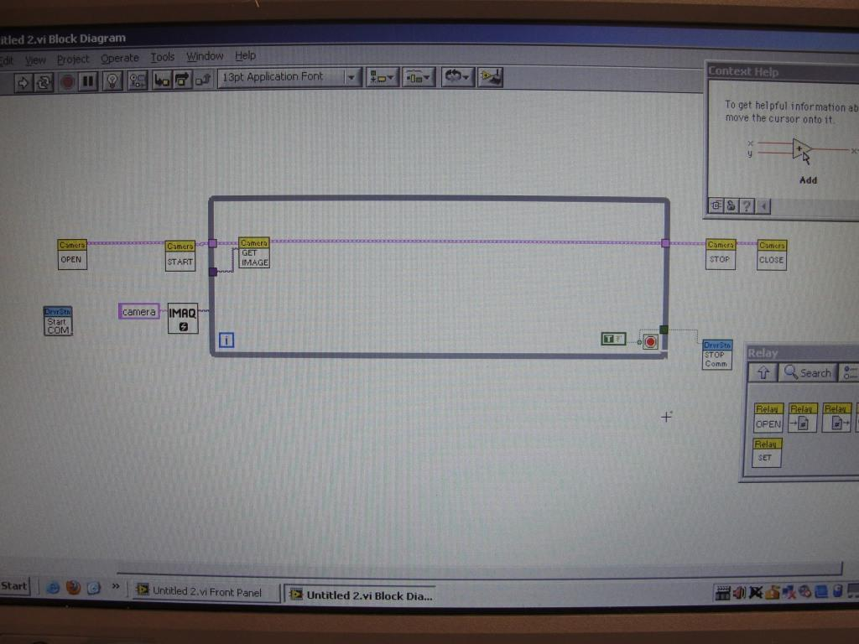
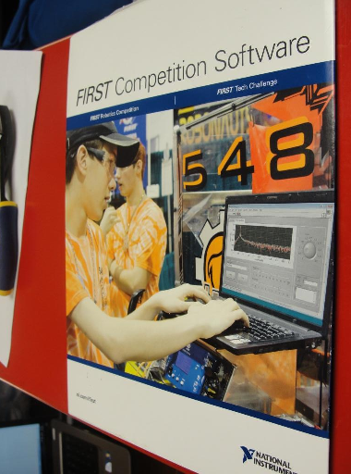
LabView Software
This is the software used to program your robot
Everything you want your robot to do will have a corresponding labview code
Labview is fun and easy once you learn how to do use it correctly

Slide 20
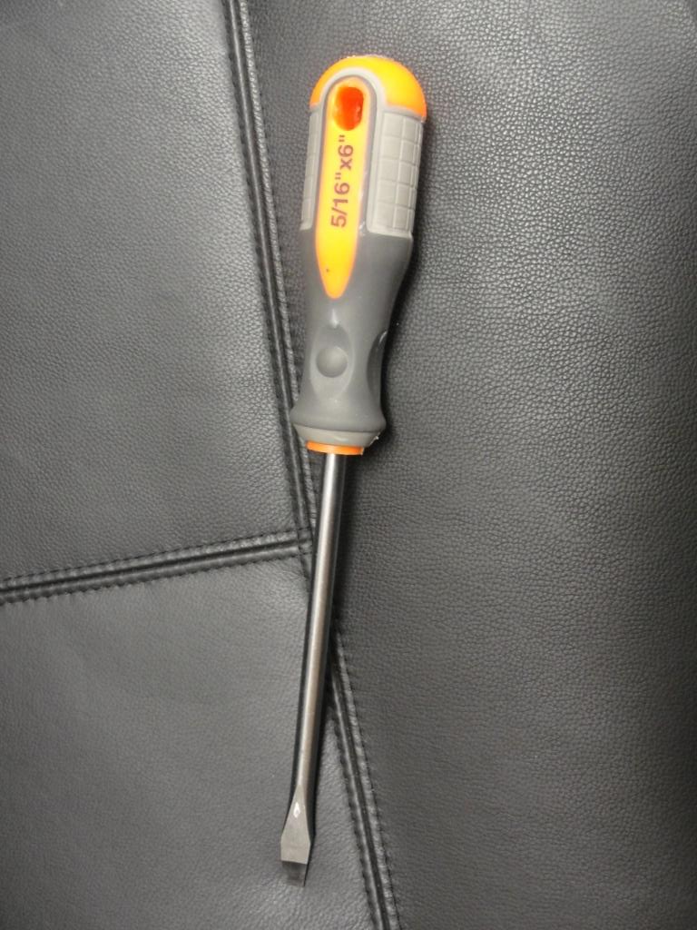
Flat head screwdriver
As many of you know, there are two different types of screwdrivers,
a flat head and a phillips head. This, of course, is a flat head due to the flat end

Slide 21
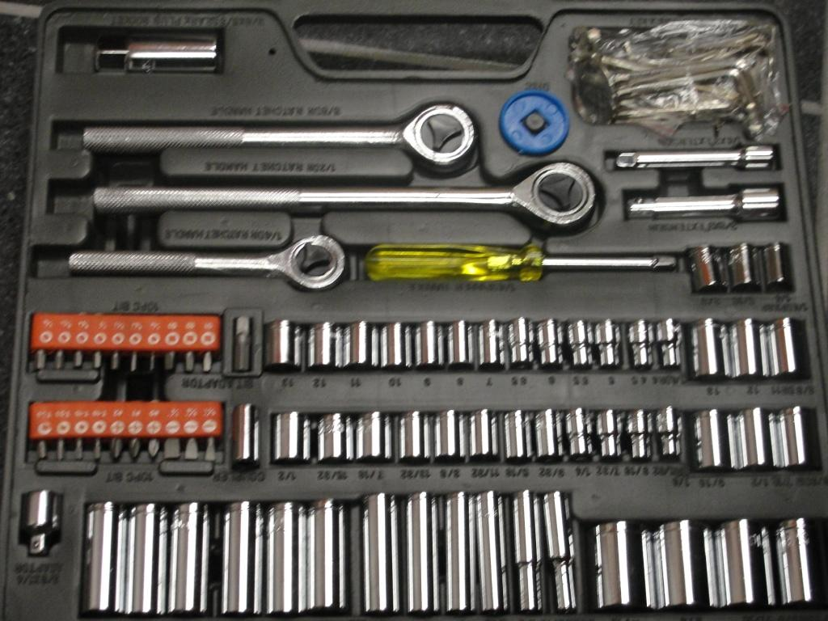
Socket Set
One of those other tools that you can't live without.
Tightening and loosening nuts and bolts of various sizes

Slide 22
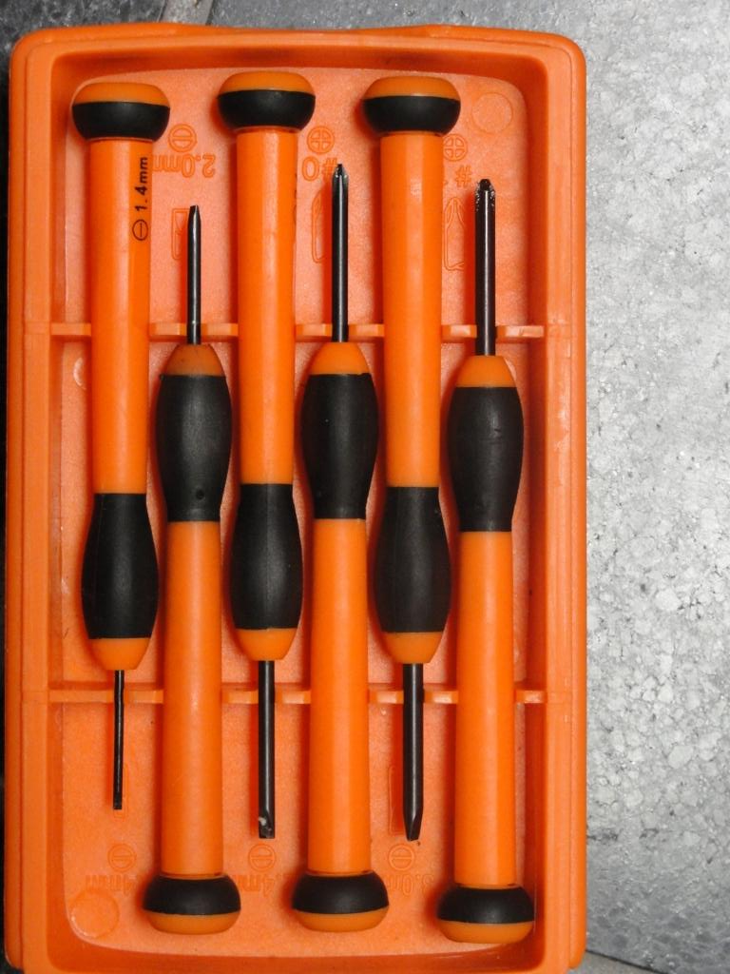
Precision Screwdrivers
Useful for those screws that are too small for a normal screwdriver.
Also may be used to place wires into the power distribution board and wago connectors

Slide 23
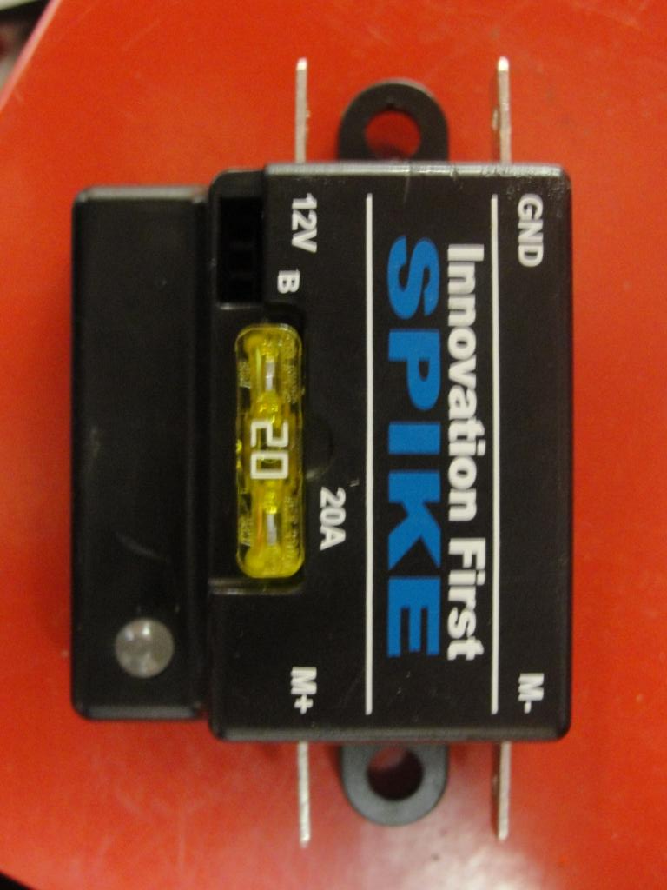
Relay Module(Spike Relay)
Provides amperage for the separate devices placed on the motor
Also, sometimes may be used to turn on and off said devices

Slide 24
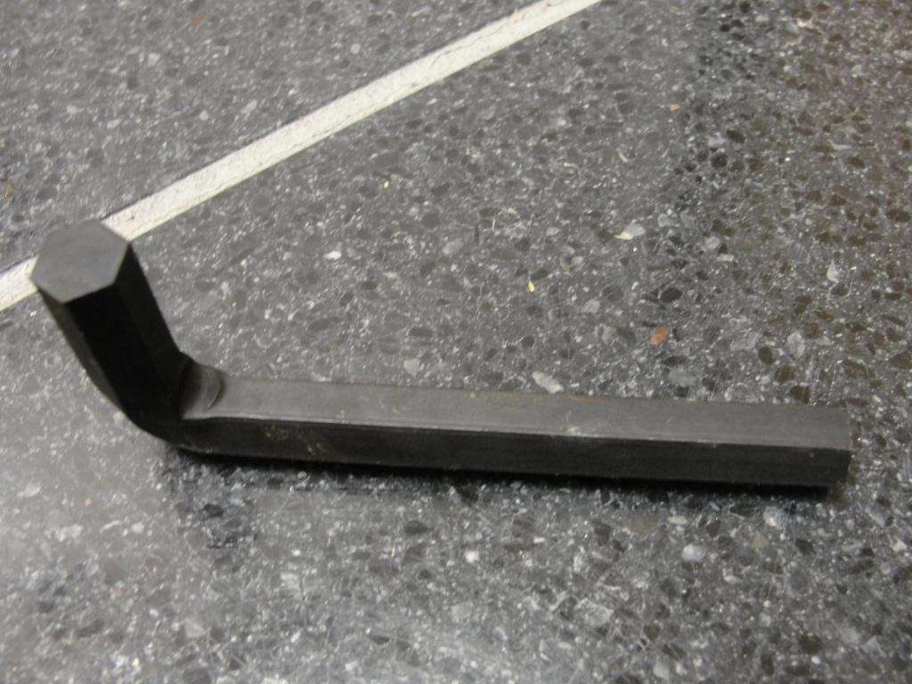
Awn/Allen/Hex Wrench
Used to tighten and place certain types of bolts on the robot frame

Slide 25
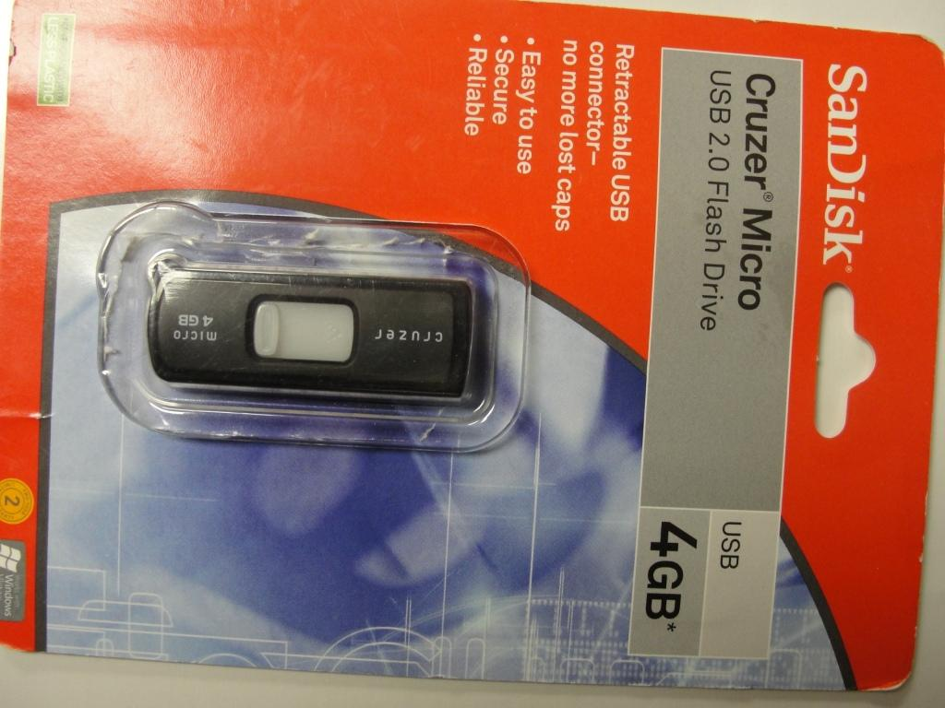
USB Restoration Key
Flash drive preloaded with a copy of the software already loaded on the Classmate PC.
You use this when your
Laptop fails, it can be the
Ultimate lifesaver

Slide 26
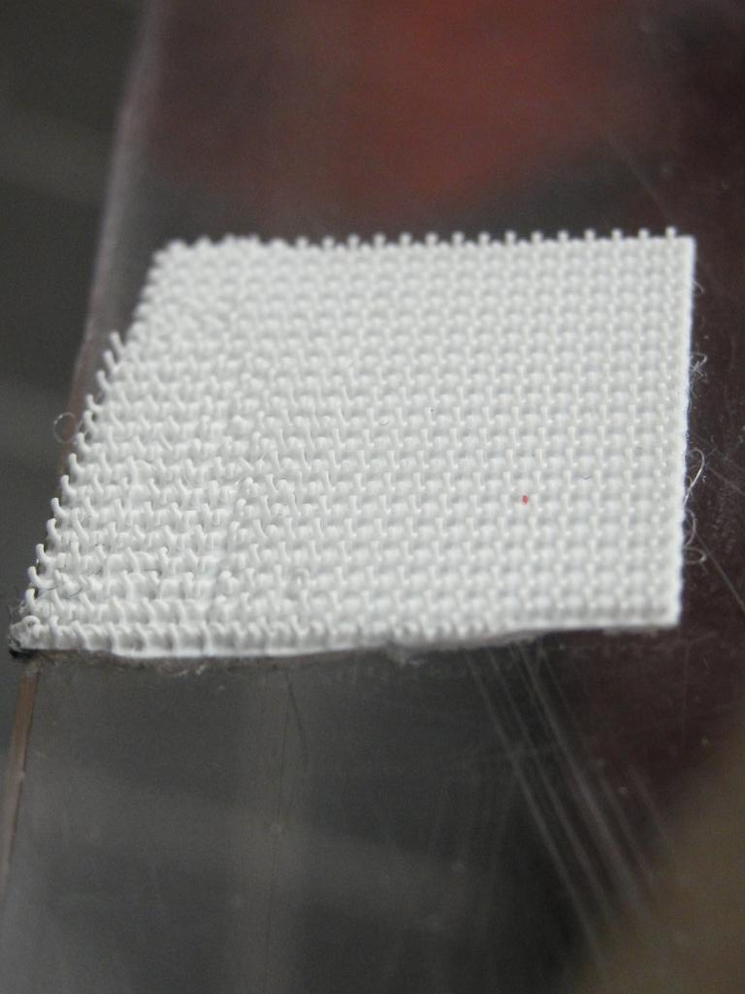
Velcro
We used velcro for EVERYTHING. It really is useful when you can pick your robot up by the battery, and the only thing holding them together
is industrial grade
velcro.

Slide 27
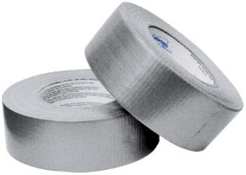
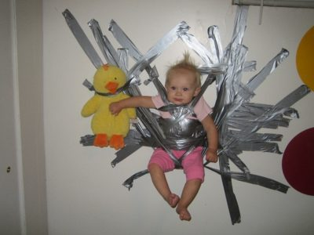
Duct Tape
Duct tape is great for attaching parts short-term while assembling.
Its surprisingly strong, as the picture shows.

Slide 28
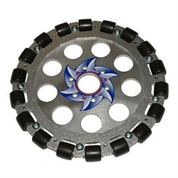
Omni-wheel
Able to be driven forward and back, can roll left and right
Can be used to achieve strafe and very odd drive system designs.

Slide 29
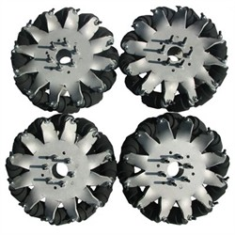
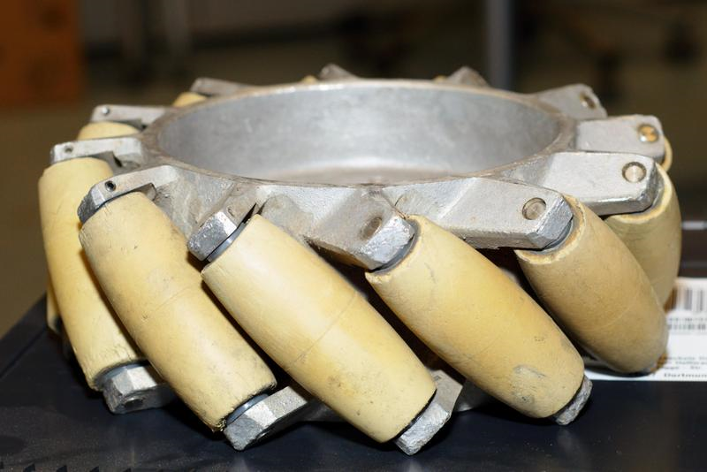
Mecanum Wheel
Able to move forward, back, strafe left and right, and turn
Require a different program to run properly, which most teams are willing to help with.
The wheels are programmed to strafe when certain wheels go forward and others back.

Slide 30
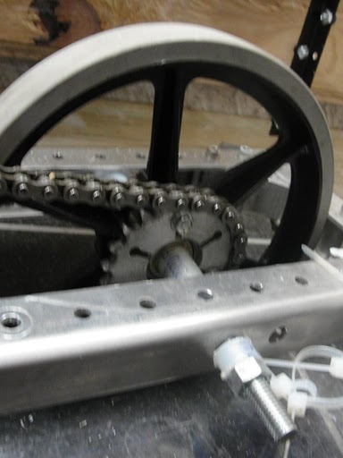
Rubber-treaded Wheel
These are the basic wheel that FIRST provides every team with.
These can reduce traction, depending on the type of playing field used

